Slide 1

Welcome!
Objective:
You will be asked to select the cultural group of the dishes you are familiar with. Based on your chosen cultural group, you will be provided with a selection of related dishes, each paired with its English dish name and a golden ingredient label sourced from Wikidata. Your task is to evaluate whether the predicted ingredients provided are indeed ingredients of the respective dishes.
Evaluation Criteria:
A predicted ingredient should be considered correct if it meets any of the following three conditions for the corresponding dish:
Direct Match: The predicted ingredient is explicitly listed in the golden label sourced from Wikidata for that dish.
Substitutability: The predicted ingredient can effectively replace a certain ingredient in the golden label during the cooking process for that dish.
Dish-Specific Ingredient: The predicted ingredient is traditionally or commonly used in the dish, even if it is not listed in the golden label from Wikidata.
Additional Instructions:
If you are not familiar with the ingredients of a particular dish, you are encouraged to search for the recipe online to gather accurate information.
Please do not directly ask ChatGPT or other AI models for the answer.
Timing: Please keep track of the time you spend on the evaluation. At the end of the task, you will be asked to provide the total time taken.
Confirmation:
Before starting the evaluation, please confirm the following:
I have thoroughly read and understood the guidelines, and I am clear about my task and the evaluation criteria.
○ Yes, I have read and understood the guidelines.
Please confirm that you are ready to start the timer and begin the evaluation.
○ Yes, I am ready to start the timer and begin the evaluation.

Slide 2
Please select the cultural group of the cuisine you are familiar with firstly. You can only choose one cultural group at a time.
下拉菜单（14个cultural group）：
Italy,
United States of America,
Turkey,
Japan,
France,
United Kingdom,
Mexico,
India,
Germany,
People's Republic of China,
Iran,
Greece,
Spain,
Russia,

Slide 3
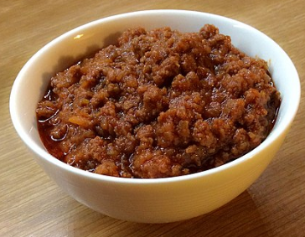
Evaluation Criteria:
A predicted ingredient should be considered correct if it meets any of the following three conditions for the corresponding dish:
Direct Match: The predicted ingredient is explicitly listed in the golden label sourced from Wikidata for that dish.
Substitutability: The predicted ingredient can effectively replace a certain ingredient in the golden label during the cooking process for that dish.
Dish-Specific Ingredient: The predicted ingredient is traditionally or commonly used in the dish, even if it is not listed in the golden label from Wikidata.
Dish name:
bolognese sauce
Golden ingredient label:
carrot, wine, milk, celery,
minced meat, onion, tomato
Please determine whether the following predicted ingredient is correct:
Predicted ingredient
ground beef
minced meat
meat
beef
pasta
label correct reason

Slide 4
How long do you spend for these dishes evaluation?

